Slide 1


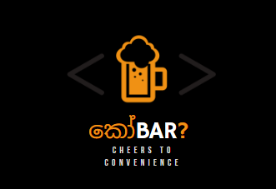

“Raise the Bar with Our App!”
Ayantha Seneviratne - CB010357

Slide 2







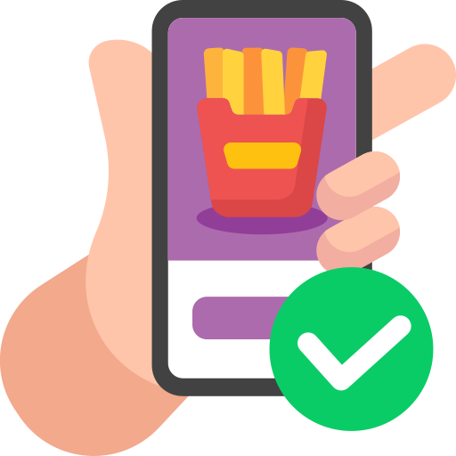


Problem vs Solution
Problem
Solution
The bar, pub, and restaurant industry lacks efficient and convenient ways for customers to order, locate, rate, and review establishments.
Customers face challenges in finding reliable information about bars, pubs, and restaurants, and traditional methods of ordering can be time-consuming.
Additionally, there is a lack of a comprehensive platform for customers to rate and review establishments, which makes it difficult for potential customers to make informed decisions.
කෝBar, the ultimate bar, pub, and restaurant locator mobile app aims to provide a seamless and user-friendly solution to address the challenges faced by both customers and establishments.
The application will offer a comprehensive platform that allows customers to order food and drinks, locate nearby bars, pubs, and restaurants, rate and review them, all in one place.
Special delivery feature that allows customers to conveniently place orders for food and drinks will enhance the convenience and accessibility of the application for both customers and establishments.

Slide 3

What is කෝBar?
Simply,
“Your Ultimate Guide to Bars, Pubs, and Restaurants - All in One App!"
Target Audience
Food and Drink Enthusiasts
Socializers
Travelers
Nightlife Seekers

Slide 4

About
Welcome to කෝBar,
The ultimate Bar, Pub, and Restaurant Locator App! The comprehensive app offers features such as exploring spots, rating and reviewing, and convenient delivery. Easily discover and connect with the best bars, pubs, and restaurants in your area. Share your experiences, enjoy reliable location services, and have food and drinks delivered to your doorstep. Join us on this exciting journey of culinary exploration with our app!
Bon appétit!
කෝBar

Slide 5


Vision & Mission
App Vision
“Revolutionize the way people discover and experience bars, pubs, and restaurants. App’s aim is to be the ultimate companion for food and drink enthusiasts, providing an intuitive and comprehensive mobile app that empowers users to effortlessly explore, savor, and socialize in the culinary and social scene. “
App Mission
“Provide a user-friendly mobile app that connects people with unforgettable dining and nightlife experiences. The app offer a list of bars, pubs, and restaurants, along with advanced search filters, locate spots and delivery options. App’s aim is to deliver exceptional value to the users, helping them make informed decisions, create cherished memories, and foster meaningful connections.“

Slide 6



List Of Screens
1
Login
5
View
2
Sign Up
6
Delivery
3
Dashboard
7
Splash
4
Locate
8
Fallback

Slide 7
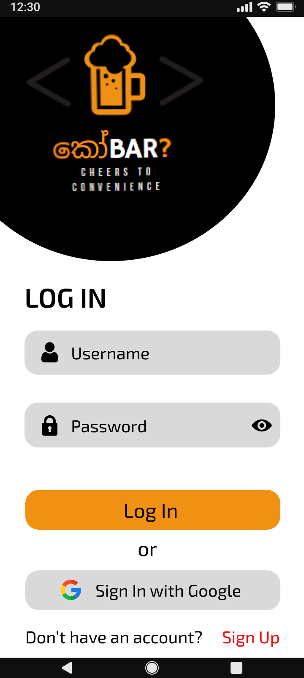
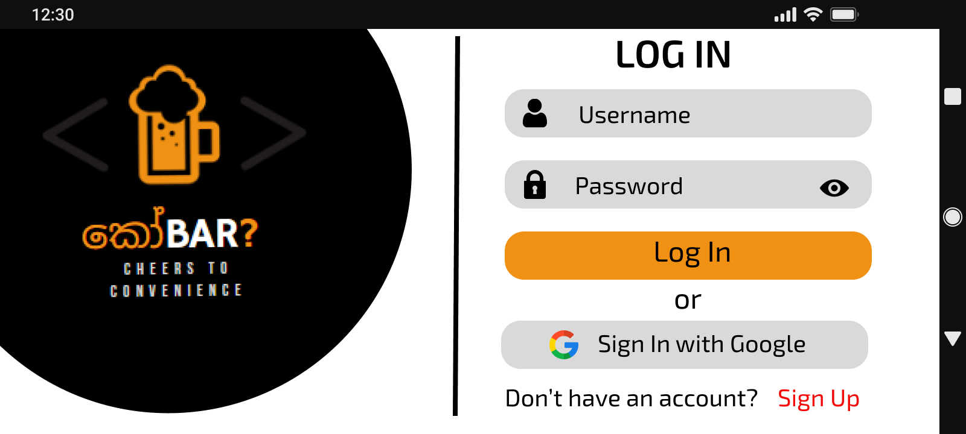
Login Screen

Slide 8
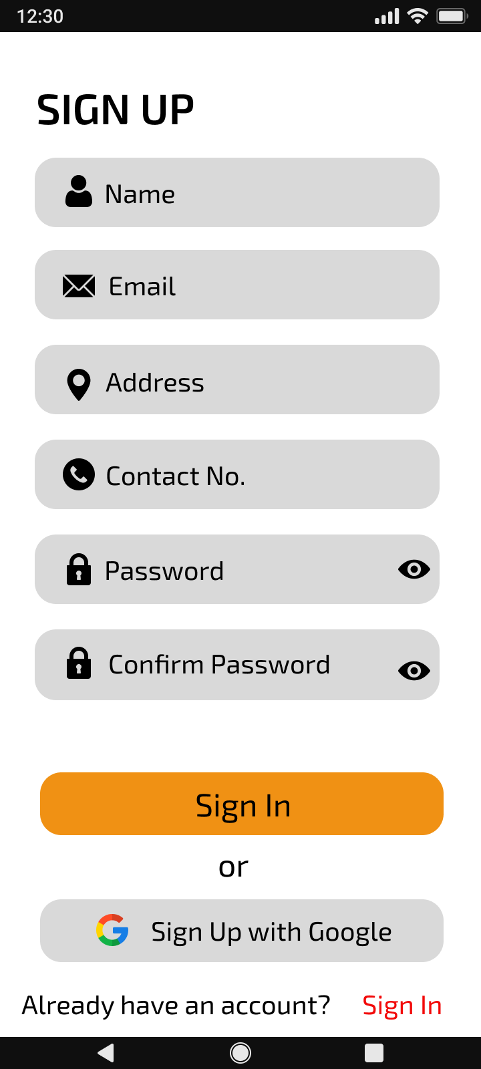
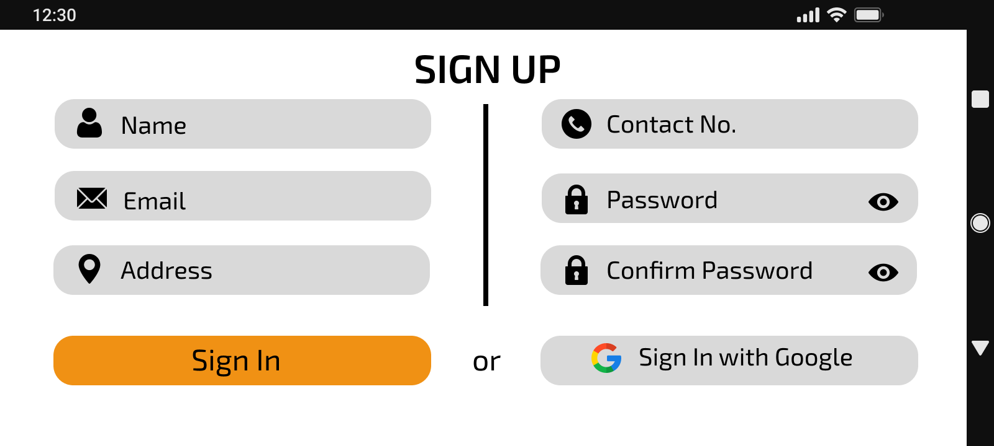
Sign Up Screen

Slide 9
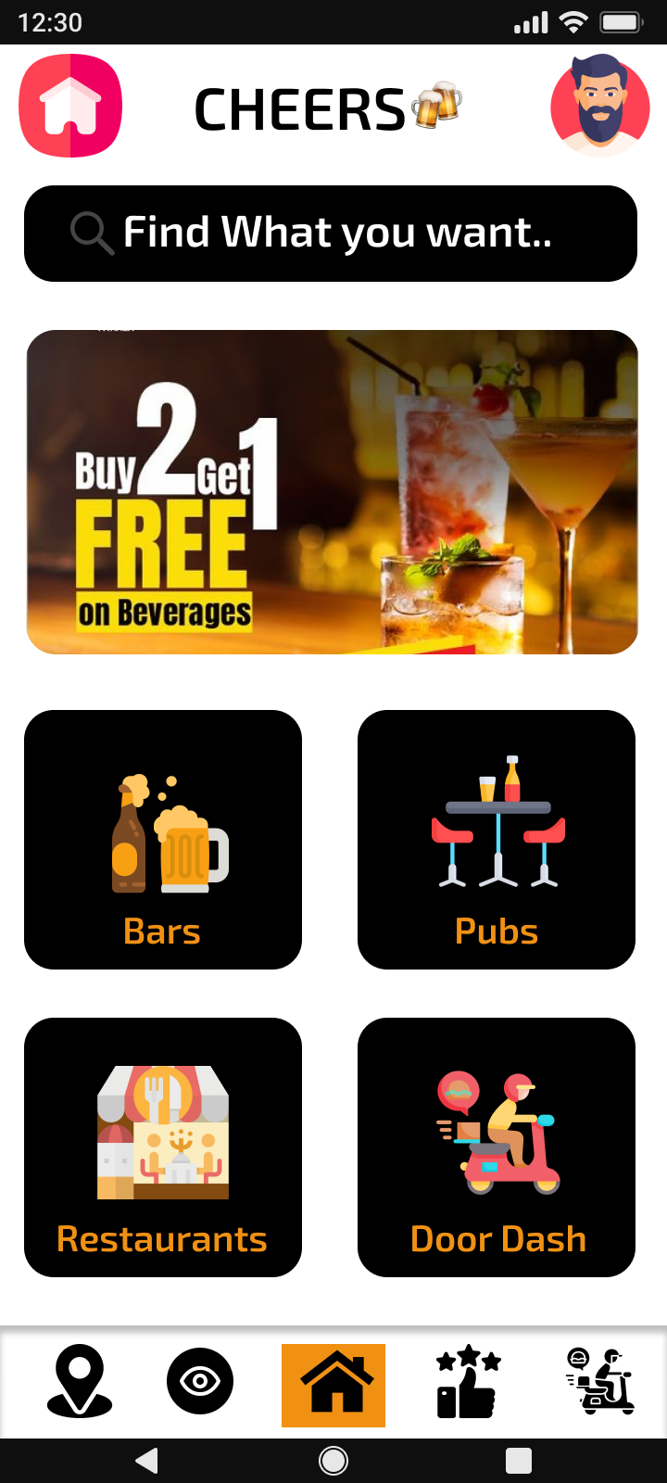
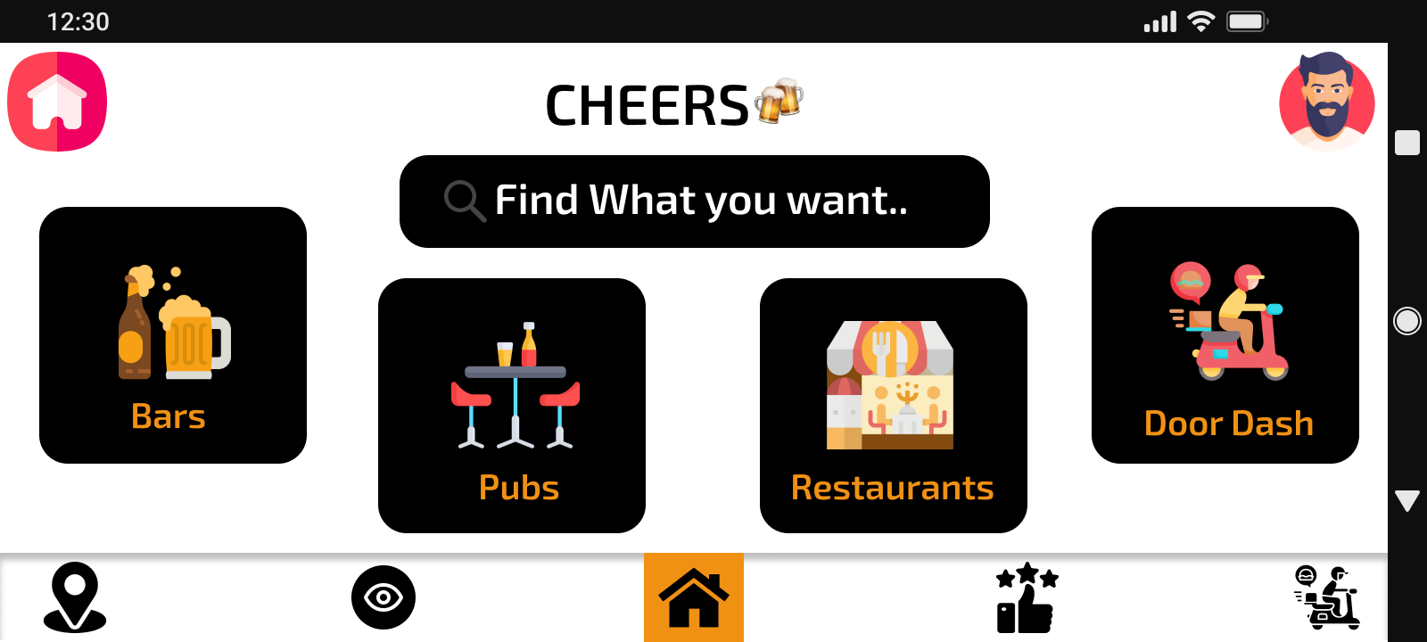
Dashboard Screen

Slide 10
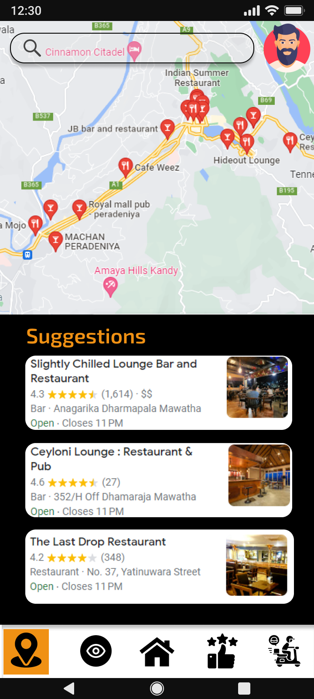
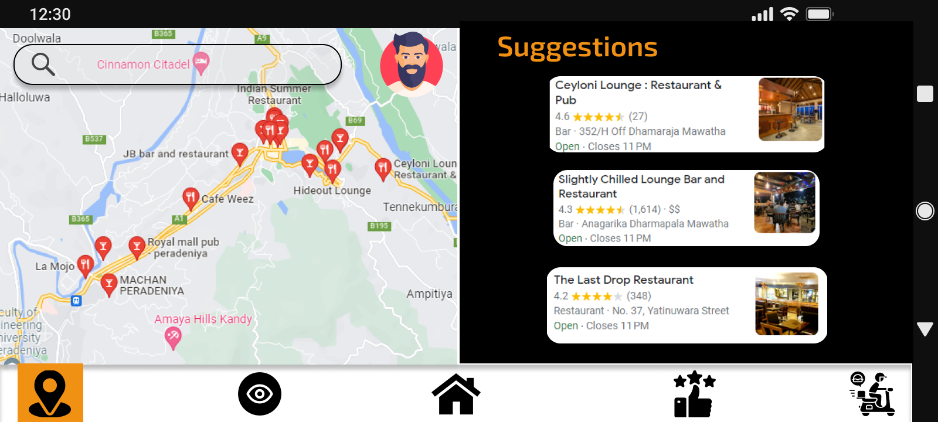
Locate Screen

Slide 11
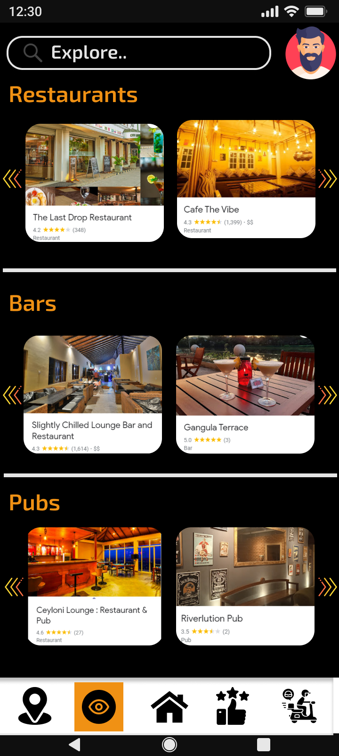
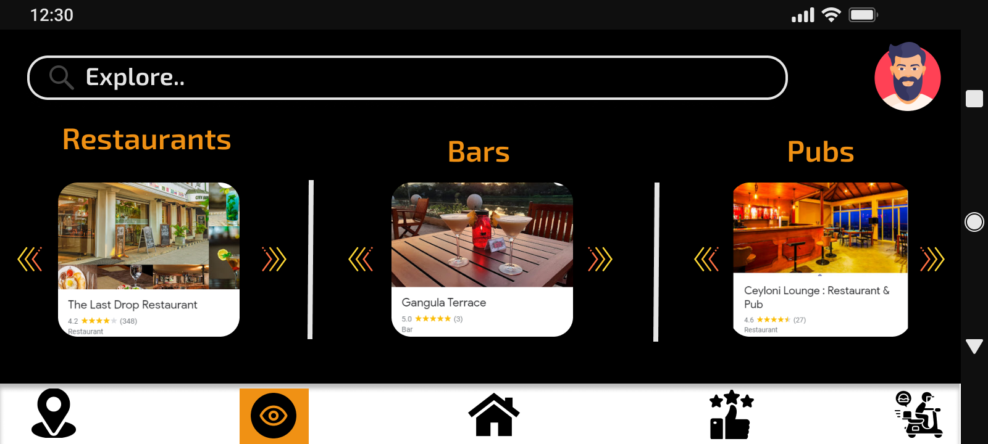
View Screen

Slide 12
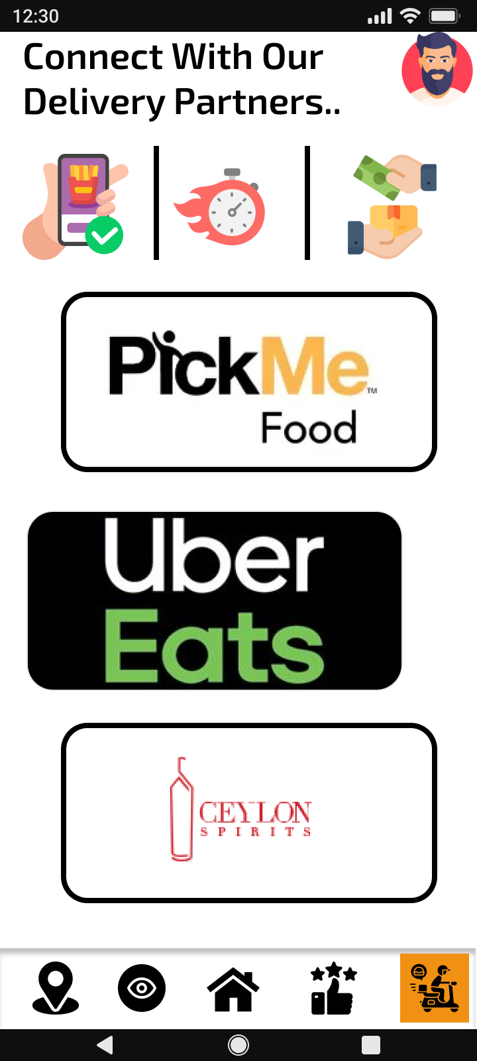
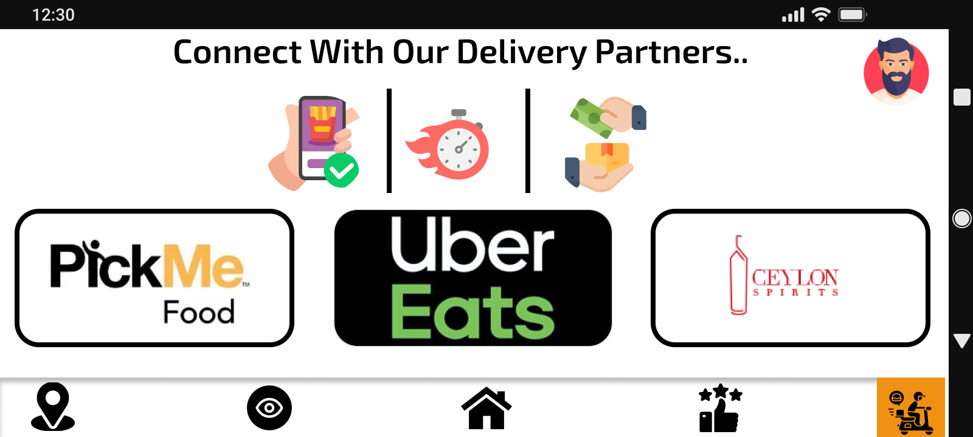
Delivery Screen

Slide 13


Splash Screen

Slide 14
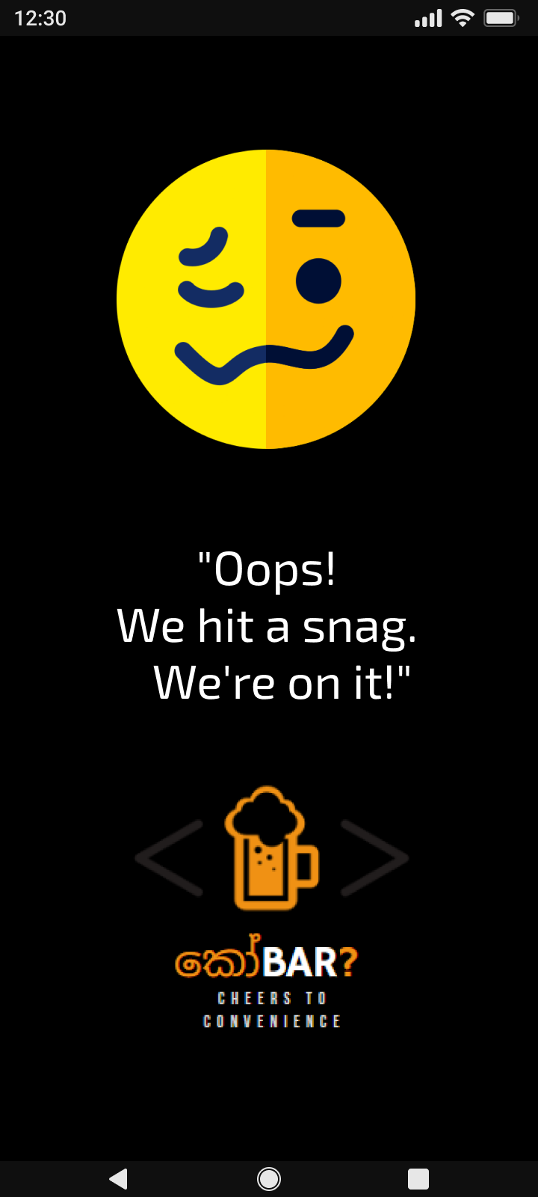
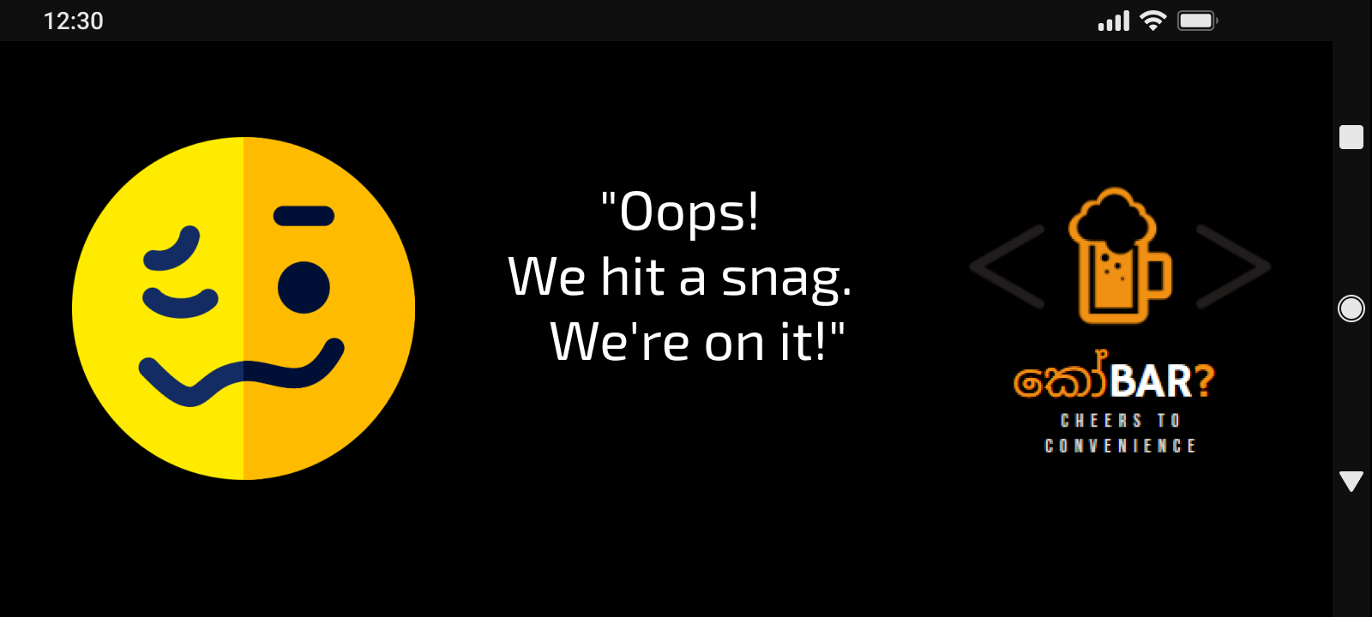
Fallback Screen

Slide 15
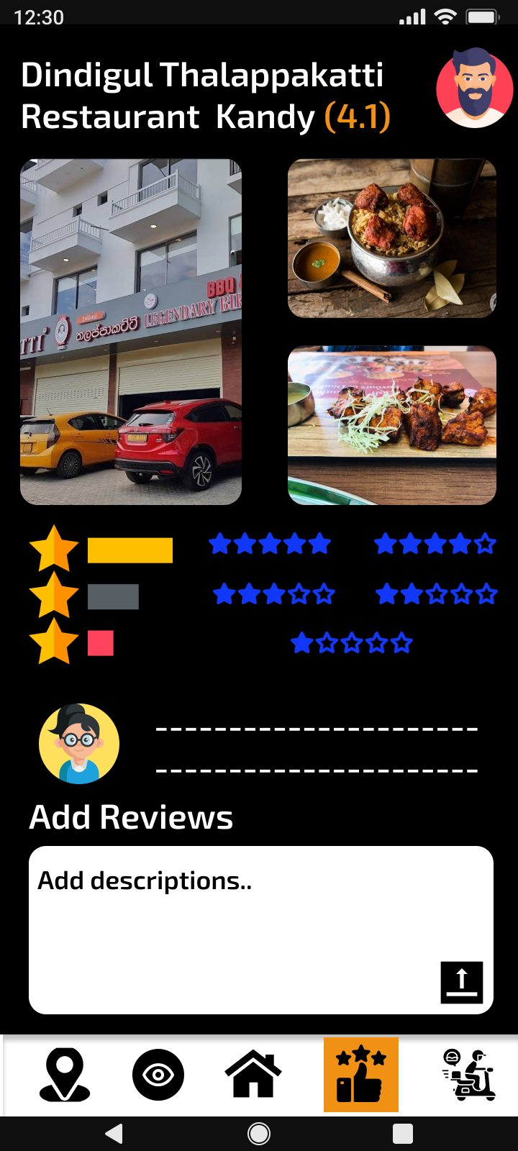
Details About Transitions
Between Screens
01
When The Login Button in the login screen is clicked, the user is directed to the Dashboard if the credentials match.
02
When the Sign-Up button in the Login screen is clicked, the user is directed to the Sign-up page
03
When the user click on Sign in button in the sign-up screen the app will direct the user to the Login screen.
04
From the Dashboard user can select bars, pubs, restaurants and the delivery service as they wish by clicking the button with icons.
05
Each screen includes a bottom navigation panel where the user can access all five screens as they wish.
06
In the Locate screen the user can simply click on a suggestion or a spot through the map and it opens in the view screen.
07
When the User click on a delivery partner through the delivery screen it opens the delivery app or the delivery service in a separate screen.
08
When the App loads it displays a splash screen for the user for like two seconds.

Slide 16



User Interaction
Discovering Spots : Users can easily explore various bars, pubs, and restaurants in their area through the app's search function. Filters can be used as well
Placing Orders for Delivery : Users can conveniently place orders for food and drinks through the app.
Locating Nearby Spots : Users can rely on the app's accurate location services to easily locate nearby bars, pubs, and restaurants.
Personalization : The app allows users to create personalized profiles to save their favorite spots, track their order history, and receive tailored recommendations based on their preferences and interests.
User-Friendly Interface : The application has a clean and clear user experience that allows users to easily explore and interact with its features.
Notes:
DS - They can use advanced filters such as location, cuisine type, price range, and ratings to find the perfect spot for their preferences and interests.
R&R - They can share their experiences, opinions, and recommendations with the community, helping other users make informed decisions and shaping the culinary scene. They can also view ratings and reviews from other users to get insights into the quality and ambiance of a spot.
PO - Whether they are hosting a party or simply craving their favorite dish or drink, they can browse menus, customize orders, and have them delivered right to their location. They can also track the status of their orders in real-time for a hassle-free experience.
LS - The app uses GPS technology to provide users with a list of spots in their vicinity, helping them plan their culinary adventures with ease. Users can also view maps, directions, and contact information for each spot to facilitate their visit.
UI - It is designed to provide a seamless and enjoyable experience, with clear icons, search bars, filters, and intuitive menus that enhance user engagement and satisfaction.

Slide 17
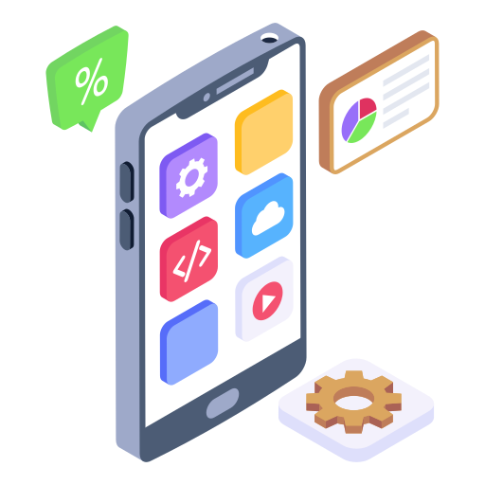





Different Approaches Taken in
Modern Mobile App Development
 | Native Apps | Progressive Web Apps
Definition | Native apps are custom built to run on specific devices and operating systems. (DiCesare, 2023) These are the apps that are downloaded from an app store or marketplace. (DiCesare, 2023) | PWAs are web-based apps with native app characteristics such as push notifications and a totally natural appearance and feel.. (DiCesare, 2023) PWAs can run offline and be installed on a device. These apps are available in the Google and Microsoft app stores. (DiCesare, 2023)
Advantages | Offers the best performance and user experience. (DiCesare, 2023) Interacts with native device features. (DiCesare, 2023) (DiCesare, 2023) Fast and responsive. (DiCesare, 2023) | Fast time to market. (DiCesare, 2023) Push notifications. (DiCesare, 2023) Native app likeness. (DiCesare, 2023) Cost effective distribution. (DiCesare, 2023)
Disadvantages | Higher upfront investment. (DiCesare, 2023) Offline functionality challengers. (DiCesare, 2023) Reduced Reach. (DiCesare, 2023) | Some device functionalities (Bluetooth, camera, etc.) are unavailable. (DiCesare, 2023) Limitation on Apple devices. (DiCesare, 2023) Security Concerns. (DiCesare, 2023)

Slide 18






Cross Platform Mobile Apps
Cross-platform mobile application development often involves the use of transpiled or hybrid app development approaches. The choice between transpiled and hybrid app development approaches depends on the specific requirements of the app, the desired performance, and the development team's expertise and preferences.
 | Transpiled Apps | Hybrid Apps
Definition | Transpiled apps, refer to software applications that are translated from one programming language to another. (Wijayagunawardene, 2023) | Hybrid applications are a blend of web and native apps.. (DiCesare, 2023) These applications are coded with cross-platform languages such as HTML5, CSS, and JavaScript.. (DiCesare, 2023)
Advantages | Platform Portability. (Wijayagunawardene, 2023) Code Reusability. (Wijayagunawardene, 2023) Developer Productivity. (Wijayagunawardene, 2023) | Fast time to market. (DiCesare, 2023) One codebase. (DiCesare, 2023) Flexibility in UI/UX Design. (DiCesare, 2023)
Disadvantages | Loss of Language-Specific Features. (Wijayagunawardene, 2023) Need to update transpiling tools as platform languages change(Wijayagunawardene, 2023) | Slower loading speeds than other apps. (DiCesare, 2023) Approaching obsolescence. (DiCesare, 2023)

Slide 19



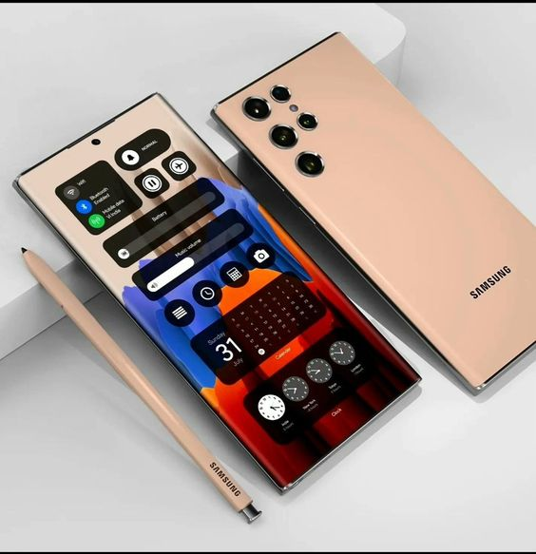
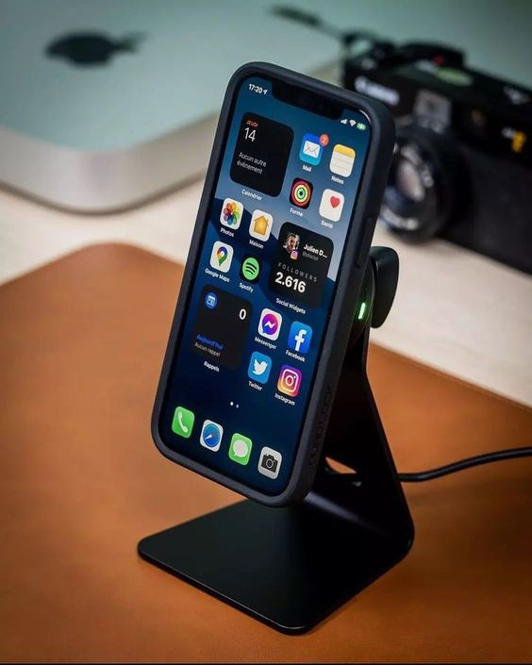
Android VS IOS
Design
Android follows Material Design. (Material,2022) Use a set of design guidelines provided by Google. (Material,2022) Emphasizes a clean and modern look with a focus on consistent use of color, typography, and iconography. (Material,2022) Material Design encourages the use of responsive layouts that adapt to different screen sizes and orientations. (Material,2022) It provides a consistent user experience across different devices and screen sizes. (Material,2022) | iPhones follow the Human Interface Guidelines (HIG) provided by Apple. (Inc.,2023) Which focuses on simplicity, clarity, and depth in design. (Inc.,2023) The HIG provides guidelines on how to create intuitive and engaging user interfaces that are consistent with the overall iOS ecosystem. (Inc.,2023) It includes guidelines for typography, color, icons, and interactions. (Inc.,2023)

Slide 20



Android VS IOS
Publishing Processes
Android apps are published on the Google Play Store, which has a relatively open submission process. (developers,2022) Android developers need to create a developer account, pay a one-time registration fee, and then upload their app's APK (Android Package) file to the Play Console. (developers,2022) Once the app is uploaded, it undergoes a review process by Google to ensure compliance with Google Play policies. (developers,2022) If approved, it becomes available for download on the Google Play Store. (developers,2022) | iPhone apps can be published through the Apple App Store, which requires developers to create an Apple Developer account. (Inc., 2023) Then submit the app for review and comply with Apple's app review guidelines. (Inc., 2023) Once approved, the app is published on the App Store and can be downloaded by users worldwide. (Inc.,2023)
Notes:
Android publishing cost – In order to publish an Android app on the Google Play Store, it is mandatory to create a Google Developer Account and pay a one-time registration fee of $25 / Roboto
IOS app publishing cost - The cost to publish an iOS app to the App Store is $99 annually or a one-time registration fee of $25 San Fransico

Slide 21
Prototype of the App
Portrait Mode :
https://www.figma.com/proto/eAZjlIwdganm2PLgYaZa4P/KOBAR?node-id=2-2&scaling=scale-down&page-id=0%3A1&starting-point-node-id=2%3A2
Landscape Mode :
https://www.figma.com/proto/eAZjlIwdganm2PLgYaZa4P/KOBAR?node-id=90-238&scaling=scale-down&page-id=85%3A237&starting-point-node-id=90%3A238

Slide 22
Material design Material Design. Available at: https://m3.material.io/ (Accessed: April 14, 2023).
Inc., A.Human interface guidelines, Human Interface Guidelines - Human Interface Guidelines - Design - Apple Developer. Available at: https://developer.apple.com/design/human-interface-guidelines/guidelines/overview/ (Accessed: April 14, 2023).
Distribute your apps & games on google play : android developers Android Developers. Available at: https://developer.android.com/distribute (Accessed: April 14, 2023).
References
Inc., A.Apple developer, Apple Developer. Available at: https://developer.apple.com/ (Accessed: April 14, 2023).
DiCesare, M. (2023) Native vs. web vs. hybrid apps vs. Pwas: The Pros & Cons, Mendix. Available at: https://www.mendix.com/blog/native-vs-web-vs-hybrid-vs-pwas/ (Accessed: April 22, 2023).
Wijayagunawardene, V. (2023) “App development and publishing,” 16 March.
Nitecki, S. and Netguru (2023) Cross-platform mobile apps development – pros and cons, Digital Acceleration Company. Netguru. Available at: https://www.netguru.com/blog/cross-platform-mobile-apps-development (Accessed: April 25, 2023).

Slide 23

Conclusion
Join with කෝBar on this exciting journey and let our app enhance your dining and nightlife experiences. Thank you for considering the app, and I look forward to serving you in creating memorable moments and discovering new culinary delights!

Slide 24

Thank You
Any Questions ?

